Slide 1
Continuous
Risk Assessment for Examiners
John Claffey
Water Safety Ireland

Slide 2
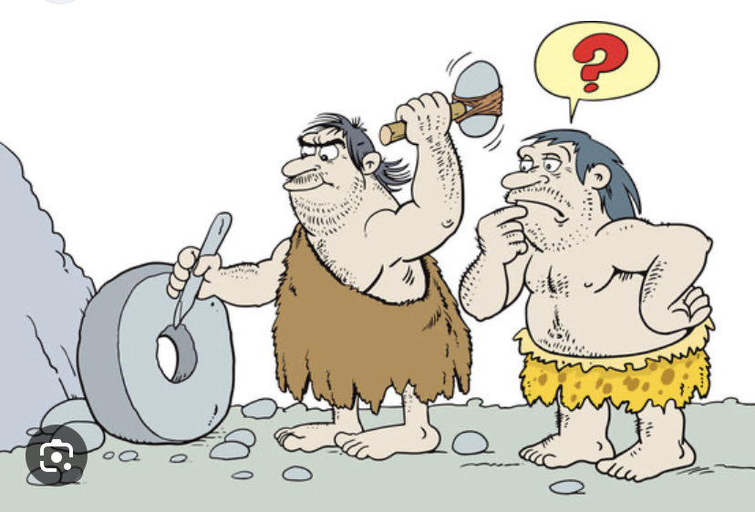
Reinventing the wheel

Slide 3
Risk Assessment
A hazard means anything that can cause harm or damage.
A risk is the chance, high or low, that somebody will be harmed by the hazard.
A risk assessment will determine how likely it is that each hazard could cause harm or damage.
This will determine whether or not action needs to be taken to remove or reduce the risk.

Slide 4
Risk Assessment Process
Identify hazards
Decide who might be harmed and how
Assess the risks and take preventative action
Record the findings
Carry out regular reviews and revise actions taken if needed

Slide 5
How to Make a Pool Safe?
Drain the pool of water?
Create a risk of a large hole - not practical
Mitigate the risk
Adapt a safety plan – pool rules
Employ lifeguards to lessen the risk

Slide 6
Pool Risk Assessments for Examiners
Ensure safety standards & prerequisites are met
Is water clarity good?
Good lighting?
Lifeguard on duty – deep water
Pool in good repair – injury risk
Class is managed properly – unruly behavior?
View log book – sufficient training completed

Slide 7
What Are You Examining?
Water Safety classes
Pool Lifeguard classes
Beach & IOW courses
Swimming & lifesaving competitions
Swim teacher courses
Trainee Instructor courses
Trainee examiner courses

Slide 8
Exam Considerations
Numbers in exam – refer to syllabus
Insurance cover
Safety cover in open water
Latest syllabi
Can the exam go ahead?

Slide 9
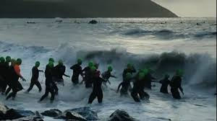
Is This Safe?

Slide 10
Open Water Exams
Weather conditions
Rough surf?
River currents – flood waters
Access and egress from exam location
Time allocated for exam – sufficient?
Hypothermia? Below 15 degrees - everyday in Ireland

Slide 11
Why RA for Examiners?
We hold the knowledge of the organization
Senior members of WSI
We are integral to the workings of our WSAC
We are obliged to maintain the highest levels of safety
Ensure standards are kept at the highest level
We all have a duty of care

Slide 12
Duty of Care
We have a duty of care to our fellow examiners
Duty of care to our fellow members
Duty of care to the organisation

Slide 13
Risk of Hypothermia
Lack of sensation makes it difficult to try save yourself
Loss of consciousness
Drowning
Cardiac arrest
Death

Slide 14
Training courses for examiners
Pool risk assessor – swimming pools
Open water risk assessor – beach & river

Slide 15
SAFETY FIRST
“THE BUCK STOPS HERE”

Slide 16
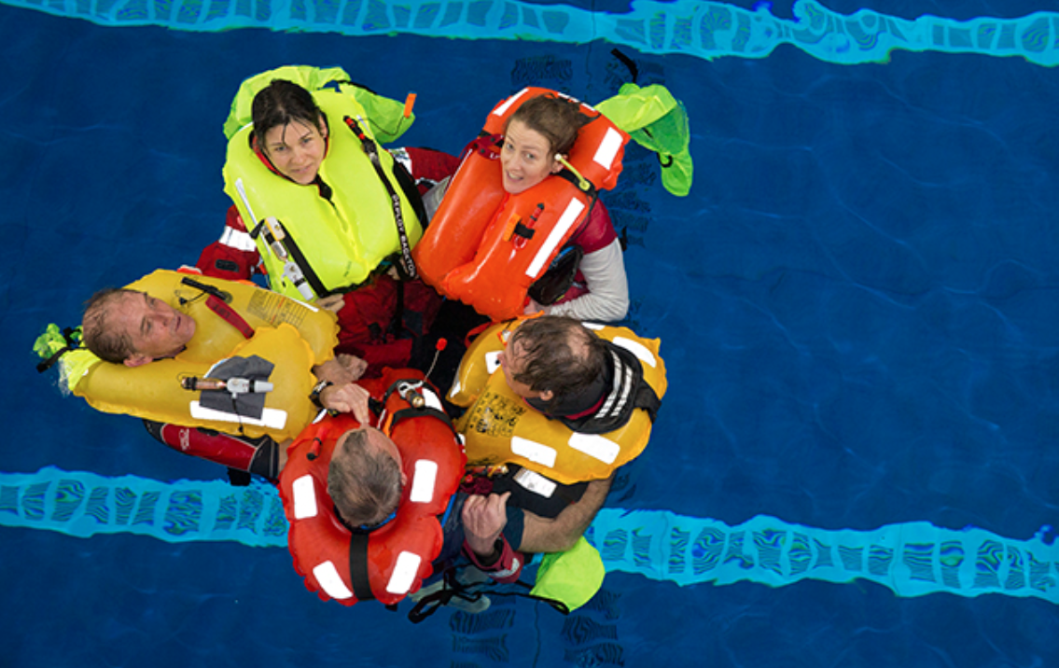
The Best Lifejacket is the One You Wear

Slide 17
Any Questions?
Thank You
John Claffey

