Slide 1
WSI Examiner’s Conference
2023
Welcome

Slide 2


Slide 3
Opening Address
Clare McGrath

Slide 4
Quiz - Question 1
How many Examiner’s registered to attend this conference ?

Slide 5
Headquarters Update
Joanne Walsh

Slide 6
Quiz - Question 2
X.X.X.X. ?– This position( legs together elbows to the side), may be adopted if wearing a buoyancy aid. It helps slow down body heat in calm water.

Slide 7
Measurement of WSI – Impact
David Ruch

Slide 8
Quiz - Question 3
What is the term used to describe the initial response of victim, unused to cold water after sudden immersion?

Slide 9
Water Safety Ireland
Break -See you in 25 mins
Restarting at 11.40

Slide 10
Quiz - Question 4
What does the following describe?
Toes of one foot grip ege of pool
Lean forward and step off edge
Slap water with palms of hands
Kick legs Vigorously

Slide 11
Examining Resuscitation- Practical Session
Leo Mahon

Slide 12
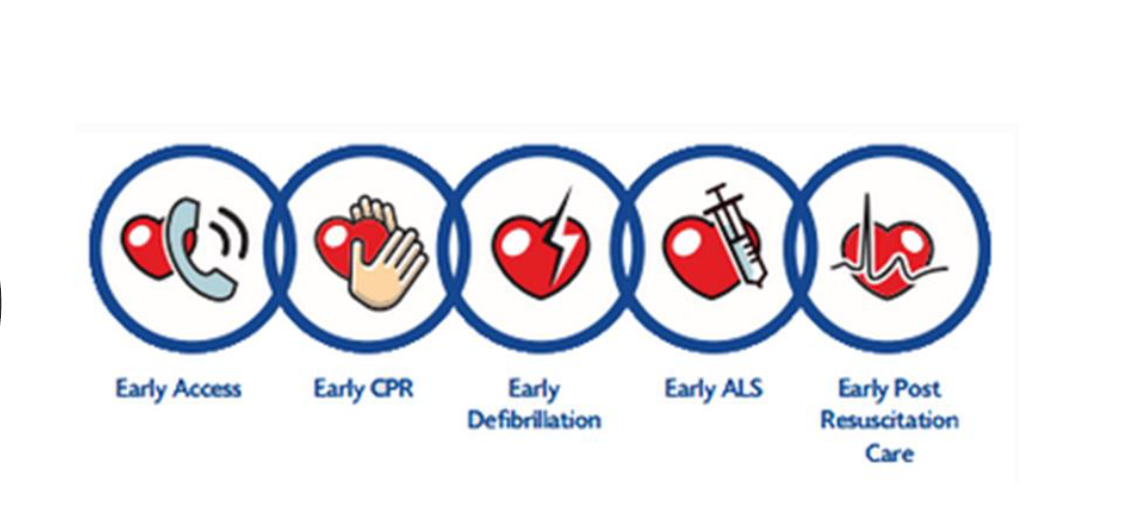
Chain of Survival

Slide 13
Did you Know ?
Almost 5,000 people die from sudden cardiac arrest
Most occur outside of hospital and death occurs within a few minutes if treatment is not started.
6.4% Increase survival from cardiac arrest over recent years for sudden out-of-hospital cardiac arrest patients.
9% Increases in the number of patients receiving bystander CPR, within minutes of the patient experiencing the cardiac arrest
From the moment of collapse, the chance of survival decreases by 7-10% per minute when CPR is not being performed
•Hesitation costs lives.

Slide 14
Message from Dr. Matthew Skills
Courses & Exams should resume the teaching, practice, and assessment of all required skills to include rescue breaths
The teaching, practice, and assessment of BVM at higher level awards should continue
Continue place a strong emphasis on hygiene and protective measures for students

Slide 15
Chain of Survival

Slide 16
Early Access
Scene Safety
•Check for response -“Shaker & Shout “
•Open Airway -Tilt head back
•Check for Normal Breading ( 10 seconds)
•Dial 112 /999
•Call for AED / Defib

Slide 17
Early CPR
Compress
Start Compressions
Centre of chest
Push hard and fast
Don’t stop till help arrives
Compression Depth
Adult; 4-5cm
Child/ Baby; 1/3 of chest

Slide 18
Early Defibrillation
Not all arrhythmias (irregular or abnormal rhythm) need defibrillation. Some arrhythmias still push blood to the body, not well, but still enough to keep a person alive.
Other types, like ventricular fibrillation or pulseless ventricular tachycardia, will cause a person to die within minutes unless treated. These are what need to be treated by defibrillation.
Fibrillation is when the heart muscle is contracting, but not in any organized way, and blood is not pumped.

Slide 19
AED Notes
Prepare the chest area.
To use the AED pads, you must
•Open or cut through clothing.
•Dry chest if wet.
•Shave chest if very hairy. Most AEDs come with a razor to shave or scissor to trim the chest of a hairy person.
•Look for signs of implanted devices, such as a pacemaker.
•Remove any metal jewellery or accessory, remove it. The metal will conduct electricity.
•Remove/cut any bra that has under wire in it. It can conduct electricity just like jewellery.
•Then apply pads -follow instruction of AED Unit
•DO NOT TOUCH the patient when delivering a “Shock”

Slide 20
Questions/ Feedback ?

Slide 21
Competition
Throw the Rope
Win a prize !

Slide 22
Water Safety Ireland
Lunch -See you in 60 mins
Restarting at 1.45PM

Slide 23
Quiz - Question 5
What does the acronym BVM stand for ?

Slide 24
Standardisation across our syllabus
Paul Murphy

Slide 25
Quiz - Question 6
What does the acronym FBAO stand for ?

Slide 26
Examining Swim Teachers, AST’s & Examiners as Quality Controllers for WSI
Paul Burke

Slide 27
Quiz - Question 7
FAST assessment
State what F A S T stand for ??

Slide 28
Continuous Risk Assessment for examiners
John Claffey

Slide 29
Open Forum/Discussion

Slide 30
Water Safety Ireland
Dinner & Presentations
Starting at 6PM

