Slide 1
Water Safety Ireland Examiners Conference October 14th 2023
Dr. Joanne Walsh CEO

Slide 4
A STRATEGIC PLAN FOR NEXT FIVE YEARS WITH CLEAR GOALS AND
OBJECTIVES

Slide 5
GOAL 1: TO PROMOTE A PUBLIC AWARENESS OF WATER SAFETY
OBJECTIVES
Position Water Safety Ireland as the leading body for the promotion of water safety awareness.
Drive adherence to water safety best practices involving all activities in, on and near water.
Foster engagement in positive, safe and confident aquatic activities.
Develop national and international strategic partnerships to encourage collaboration on water safety.
Publish and communicate water safety related data.

Slide 6
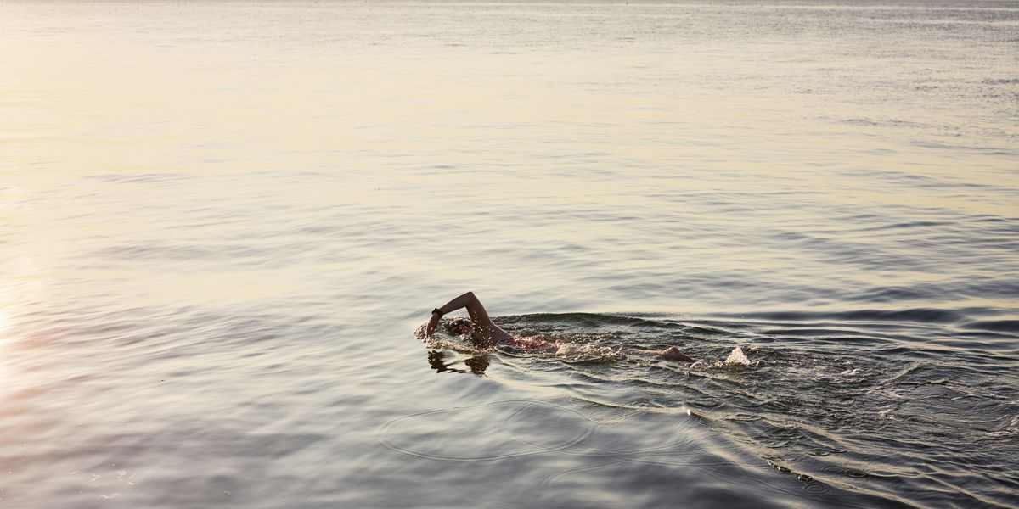
Water Safety Ireland Research Study
(May 2023 Version 1.1)
For more information, contact Oisin Byrne, Managing Director
Phone: 01-214-3741 Email: oisin.byrne@ireachhq.com
Notes:
6

Slide 7
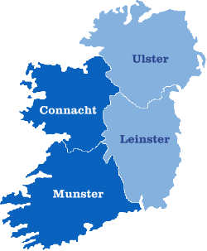
Water Safety Ireland Research Study
OMNIBUS DEMOGRAPHICS
Education
Gender
Age of respondents
Marital Status
Primary
2%
Secondary
33%
Third
45%
Post
graduate
20%
Single/Never Married
18-24
41%
25-34
Married/Cohabiting
35-44
51%
45-54
Separated/Divorced/Widowed
49%
51%
7%
Prefer not to say
Occupation
1%
High managerial, admin, professional
6%
Intermediate managerial, admin, professional
9%
Children at Home
Household Income
Region
Supervisor, Jr managerial, admin, professional
34%
7%
Manual worker (skilled, non-skilled)
15%
19%
< €19,999 | 24%
€20K - €39,999 | 28%
€40K - €59,999 | 24%
€60K - €79,999 | 15%
€80K+ | 7%
Prefer not to say | 2%
Don’t know | 0%
Self Employed
3%
12%
10%
Casual Worker – Not Permanent Employment
1%
22%
Dublin29%
Homemaker
6%
7%
Unemployed
6%
None
62%
32%
Student
8%
Retired (on state, private pension)
12%
Full Time Carer
1%

Slide 8
Water Safety Ireland Research Study
OMNIBUS QUESTIONS
Q1. Do you believe that swimming is a necessary life skill? (Single select)
Q2. Do you believe that water safety education is a necessary life skill? (Single select)
Q3. Do you wear a lifejacket when pursuing water-based activities such as boating, canoeing or angling? (Single select)
Q4. Have you ever found yourself in difficulty in water? Please select all that apply. (Multiple select)
Q5. How do you rate the level of water safety knowledge held by yourself and, if relevant, any child(ren) in your care: (Single grid)
Q6. Have you seen any advertisements regarding water safety recently? (Single select)
Q7. Did you take any action after seeing water safety advertising? Please select all that apply. (Multiple select)
Q8. What do you think is the number of lives lost to drownings in Ireland every month? (Numeric)
Q9. Has any child in your care received any of the following water safety education programmes: (Single grid)
Q10. Which organisation do you most associate with educating people about water safety to prevent drownings? (Single select)
Questions

Slide 9
Water Safety Ireland Research Study
EXECUTIVE SUMMARY
iReach Insights conducted this research for Water Safety Ireland, examining awareness of water safety in Ireland. The research conducted is nationally representative by Age, Gender, Region, SES demographics and received 1,000 responses. The research report provides insights into association of swimming and water education as life skills and water safety knowledge. The report also provides insights into the effects of water safety advertising and actions taken.
OVERVIEW
Life Skills and Life Jackets
Almost 4 in 5 (78%) say swimming is a necessary life skill, up a further 4% from 2019.
More than 4 in 5 (83%) say water education is very or extremely necessary.
4 in 5 (80%) say they wear a lifejacket when pursuing water-based activities, up significantly (17%) from 2019.
Difficulty in Water / Safety Knowledge
31% of all adults have had Difficulty in Water, down from 45% in 2017.
Those that experienced difficulties in swimming pools is down 6% from 2017 to 15%
There has been a significant drop in water safety knowledge (57%, down 25% from 2017%) for adults.
More than half (56%) say their child(ren)’s water safety knowledge is good or better, down 14%.
KEY
POINTS
Advertising
More than 1 in 4 (28%) say they have seen advertisements for water safety recently.
Keeping a close eye on family and friends when swimming (33%) was the most common action taken after seeing water safety advertising.
2 in 3 (67%) took at least one form of action upon seeing the advertising.
Preventing Drownings
The average estimation of lives lost to drownings each month in Ireland is 12.
Water Safety Ireland (50%) is still the most associated with educating people about water safety to promote drownings, though down 3% from 2017.

Slide 10
Almost 4 in 5 (78%) say swimming is a necessary life skill, up a further 4% from 2019.
Swimming Necessary Life Skill
Extremely Necessary
Very Necessary
Fairly Necessary
Not Very Necessary
Not At All Necessary
49%
29%
12%
3%
7%
78%
22%
2019
74%
2019
26%
2017
68%
2017
32%
Q: Do you believe that swimming is a necessary life skill? (Single select, n=1000).
7

Slide 11
More than 4 in 5 (83%) say water education is very or extremely necessary.
Water Safety Education Necessary Life Skill
Extremely Necessary
Very Necessary
Fairly Necessary
Not Very Necessary
Not At All Necessary
54%
29%
9%
2%
6%
83%
17%
Q: Do you believe that water safety education is a necessary life skill? (Single select, n=1000).
7

Slide 12
4 in 5 (80%) say they wear a lifejacket when pursuing water-based activities, up significantly (17%) from 2019.
Wearing Life Jacket
80%
“Do you wear a lifejacket when pursuing water-based activities such as boating, canoeing or angling?” – Question in 2023
Wear a lifejacket when pursuing water-based activities
2019
2017
“Other than when swimming, the last time you went on or near water to pursue a water-based activity such as boating or angling, did you wear a lifejacket?” – Question in 2017/2019
63%
66%
Q: Do you wear a lifejacket when pursuing water-based activities such as boating, canoeing or angling? (Single select, n=1000).

Slide 13
31% of all adults have had Difficulty in Water, down from 45% in 2017. All bar one water-based activity has seen a decrease, especially those that experienced difficulties in swimming pools (down 6% to 15%). 15% now say they’ve experienced difficulty in the sea, down 4% from 2017.
Difficulty in Water
2023
2017
2023
2017
A Swimming Pool
Canal
15%
21%
2%
3%
The Sea
Quarry
15%
19%
1%
2%
A Lake
Had difficulty in water
5%
4%
31%
45%
A River
I’ve never had any difficulty in water
3%
5%
69%
55%
Q: Have you ever found yourself in difficulty in water? Please select all that apply. (Multiple select, n=1000).

Slide 14
There has been a significant drop in water safety knowledge (57%, down 25% from 2017%) for adults.
Level of Water Safety Knowledge - Yourself
1- Poor
2- Moderate
3- Good
4- Very Good
5- Excellent
2023
15%
28%
32%
17%
8%
57%
2017
7%
11%
40%
29%
13%
82%
Q: How do you rate the level of water safety knowledge held by yourself and, if relevant, any child(ren) in your care: (Single select, n=1000).
7

Slide 15
More than half (56%) say their child(ren)’s water safety knowledge is good or better, though this has decreased 14% from 2017.
Level of Water Safety Knowledge – Your Child(ren)
1- Poor
2- Moderate
3- Good
4- Very Good
5- Excellent
2023
15%
29%
31%
21%
4%
56%
2017
13%
17%
35%
23%
12%
70%
Q: How do you rate the level of water safety knowledge held by yourself and, if relevant, any child(ren) in your care: (Single select, n=385).
7

Slide 16
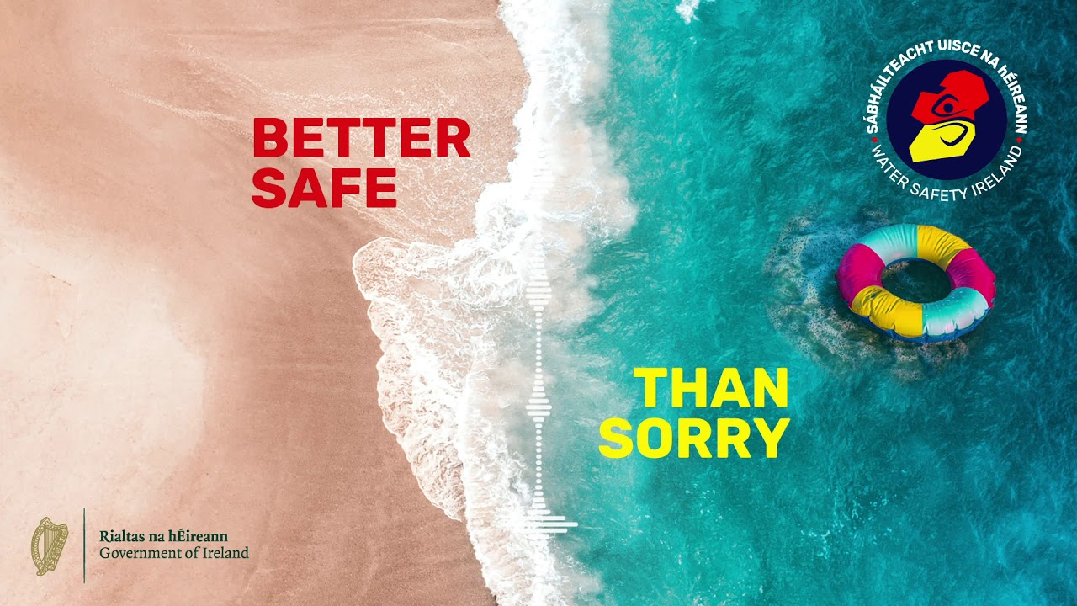
More than 1 in 4 (28%) say they have seen advertisements for water safety recently.
Advertisements for Water Safety
28%
Have seen advertisements recently
Q: Have you seen any advertisements regarding water safety recently? (Single select, n=1000).

Slide 17
Keeping a close eye on family and friends when swimming (33%) was the most common action taken after seeing water safety advertising. Just 1 in 3 (33%) say they took no action, meaning that 2 in 3 (67%) took at least one form of action upon seeing the advertising.
Taken Action After Seeing Advertisements
Provide constant, uninterrupted adult supervision to children
22%
Kept a close eye on family and friends when swimming
33%
Visited watersafety.ie
14%
Reminded children to be safe/stay within their depth
31%
Enrolled in lifesaving classes
5%
Made sure Lifeguard was on duty before swimming
26%
Some action
67%
Made sure Lifejacket was worn when boating or when angling
26%
None or no action
33%
Q: Did you take any action after seeing water safety advertising? Please select all that apply. (Multiple select, n=276).

Slide 18
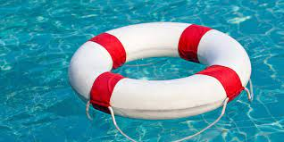
The average estimation of lives lost to drownings each month in Ireland is 12.
Number of Lives Lost to Drownings Every Month
Average
12
Q: What do you think is the number of lives lost to drownings in Ireland every month? (Numeric, n=1000).

Slide 19
Of those with creche-aged children, 20% say they’re aware that their child has received education in the “Hold Hands” programme. 13% of primary and secondary parents say the same for their respective children’s programmes, PAWS and WISE.
Water Safety Education Programmes
Yes
Don’t Know
No
“HOLD HANDS” in creches and Early Learning Centres (www.holdhands.ie)
Parents with children aged 1-4
20%
65%
15%
“PAWS” in primary schools (www.teachpaws.ie)
Parents with children aged 5-12
13%
47%
40%
“WISE” in secondary schools (www.teachwise.ie)
Parents with children aged 13-17
13%
43%
44%
Q: Has any child in your care received any of the following water safety education programmes: (Single grid, n=68, 160, 107).

Slide 20
Water Safety Ireland (50%) is still the most associated with educating people about water safety to promote drownings, though down 3% from 2017.
Preventing Drownings
2023
2017
2023
2017
Water Safety Ireland
Bord Lascaigh Mhara
50%
53%
2%
1%
Irish Coastguard
Other
16%
11%
1%
0%
RNLI
Don’t know
15%
11%
16%
16%
Q: Which organisation do you most associate with educating people about water safety to prevent drownings? (Single select, n=1000).

Slide 21
Water Safety Ireland Research Study
EXECUTIVE SUMMARY
iReach Insights conducted this research for Water Safety Ireland, examining awareness of water safety in Ireland. The research conducted is nationally representative by Age, Gender, Region, SES demographics and received 1,000 responses. The research report provides insights into association of swimming and water education as life skills and water safety knowledge. The report also provides insights into the effects of water safety advertising and actions taken.
OVERVIEW
Life Skills and Life Jackets
Almost 4 in 5 (78%) say swimming is a necessary life skill, up a further 4% from 2019.
More than 4 in 5 (83%) say water education is very or extremely necessary.
4 in 5 (80%) say they wear a lifejacket when pursuing water-based activities, up significantly (17%) from 2019.
Difficulty in Water / Safety Knowledge
31% of all adults have had Difficulty in Water, down from 45% in 2017.
Those that experienced difficulties in swimming pools is down 6% from 2017 to 15%
There has been a significant drop in water safety knowledge (57%, down 25% from 2017%) for adults.
More than half (56%) say their child(ren)’s water safety knowledge is good or better, down 14%.
KEY
POINTS
Advertising
More than 1 in 4 (28%) say they have seen advertisements for water safety recently.
Keeping a close eye on family and friends when swimming (33%) was the most common action taken after seeing water safety advertising.
2 in 3 (67%) took at least one form of action upon seeing the advertising.
Preventing Drownings
The average estimation of lives lost to drownings each month in Ireland is 12.
Water Safety Ireland (50%) is still the most associated with educating people about water safety to promote drownings, though down 3% from 2017.

Slide 22
PARAMOUNT TO THIS STRATEGY ARE OUR VOLUNTEERS.
THANK YOU.

Slide 24
APPENDIX

Slide 25
Swimming Necessary Life Skill
Do you believe that swimming is a necessary life skill?
Cell content: Column% Chi2 level(W): 5 |  | What gender are you? |  | Age |  |  |  |  |  |  |  |  | Socio-Economic Status
 | Total | Male | Female | 18-24 | 25-34 | 35-44 | 45-54 | 55+ | Dublin | Rest of Leinster | Munster | Connacht + Ulster | ABC1 | C2DE
Sample Size | 1000 | 489 | 511 | 110 | 185 | 209 | 175 | 321 | 289 | 220 | 319 | 166 | 494 | 430
Extremely necessary | 49 % | 40 % | 57 % | 26 % | 40 % | 47 % | 51 % | 62 % | 49 % | 44 % | 52 % | 50 % | 47 % | 49 %
Very necessary | 29 % | 30 % | 28 % | 41 % | 35 % | 28 % | 26 % | 23 % | 31 % | 32 % | 26 % | 28 % | 30 % | 30 %
Fairly necessary | 12 % | 15 % | 10 % | 5 % | 11 % | 18 % | 15 % | 10 % | 10 % | 10 % | 13 % | 15 % | 11 % | 12 %
Not very necessary | 3 % | 3 % | 3 % | 3 % | 1 % | 4 % | 3 % | 3 % | 3 % | 3 % | 2 % | 2 % | 4 % | 2 %
Not at all necessary | 7 % | 12 % | 2 % | 25 % | 12 % | 3 % | 5 % | 2 % | 7 % | 11 % | 6 % | 5 % | 7 % | 8 %

Slide 26
Water Safety Education Necessary Life Skill
Do you believe that water safety education is a necessary life skill?
Cell content: Column% Chi2 level(W): 5 |  | What gender are you? |  | Age |  |  |  |  |  |  |  |  | Socio-Economic Status
 | Total | Male | Female | 18-24 | 25-34 | 35-44 | 45-54 | 55+ | Dublin | Rest of Leinster | Munster | Connacht + Ulster | ABC1 | C2DE
Sample Size | 1000 | 489 | 511 | 110 | 185 | 209 | 175 | 321 | 289 | 220 | 319 | 166 | 494 | 430
Extremely necessary | 54 % | 43 % | 64 % | 26 % | 46 % | 54 % | 56 % | 66 % | 53 % | 50 % | 57 % | 56 % | 53 % | 54 %
Very necessary | 28 % | 31 % | 26 % | 41 % | 31 % | 26 % | 27 % | 25 % | 30 % | 32 % | 25 % | 27 % | 29 % | 29 %
Fairly necessary | 9 % | 13 % | 6 % | 5 % | 11 % | 14 % | 11 % | 7 % | 10 % | 7 % | 11 % | 9 % | 10 % | 9 %
Not very necessary | 2 % | 2 % | 2 % | 3 % | 4 % | 1 % | 3 % | 0 % | 2 % | 0 % | 2 % | 4 % | 3 % | 1 %
Not at all necessary | 6 % | 11 % | 2 % | 25 % | 8 % | 5 % | 3 % | 1 % | 5 % | 11 % | 6 % | 3 % | 6 % | 7 %

Slide 27
Wearing Life Jacket
Do you wear a lifejacket when pursuing water-based activities such as boating, canoeing or angling?
Cell content: Column% Chi2 level(W): 5 |  | What gender are you? |  | Age |  |  |  |  |  |  |  |  | Socio-Economic Status
 | Total | Male | Female | 18-24 | 25-34 | 35-44 | 45-54 | 55+ | Dublin | Rest of Leinster | Munster | Connacht + Ulster | ABC1 | C2DE
Sample Size | 605 | 299 | 307 | 48 | 136 | 132 | 104 | 186 | 183 | 119 | 194 | 108 | 323 | 240
Yes | 80 % | 74 % | 85 % | 59 % | 77 % | 79 % | 83 % | 86 % | 81 % | 69 % | 84 % | 80 % | 78 % | 82 %
No | 20 % | 26 % | 15 % | 41 % | 23 % | 21 % | 17 % | 14 % | 19 % | 31 % | 16 % | 20 % | 22 % | 18 %

Slide 28
Difficulty in Water
Have you ever found yourself in difficulty in water? (Please select all that apply).
Cell content: Column% Chi2 level(W): 5 |  | What gender are you? |  | Age |  |  |  |  |  |  |  |  | Socio-Economic Status
 | Total | Male | Female | 18-24 | 25-34 | 35-44 | 45-54 | 55+ | Dublin | Rest of Leinster | Munster | Connacht + Ulster | ABC1 | C2DE
Sample Size | 1000 | 489 | 511 | 110 | 185 | 209 | 175 | 321 | 289 | 220 | 319 | 166 | 494 | 430
A swimming pool | 15 % | 12 % | 18 % | 10 % | 24 % | 14 % | 14 % | 12 % | 17 % | 15 % | 13 % | 12 % | 16 % | 14 %
The sea | 15 % | 16 % | 14 % | 5 % | 20 % | 15 % | 17 % | 14 % | 18 % | 16 % | 16 % | 8 % | 18 % | 12 %
A lake | 5 % | 7 % | 4 % | 15 % | 6 % | 8 % | 1 % | 2 % | 3 % | 11 % | 4 % | 4 % | 3 % | 8 %
A river | 3 % | 3 % | 3 % | 0 % | 6 % | 1 % | 5 % | 3 % | 5 % | 4 % | 2 % | 0 % | 1 % | 5 %
Canal | 2 % | 2 % | 2 % | 0 % | 5 % | 4 % | 1 % | 0 % | 5 % | 2 % | 0 % | 1 % | 3 % | 2 %
Quarry | 1 % | 1 % | 1 % | 0 % | 1 % | 3 % | 0 % | 0 % | 1 % | 2 % | 0 % | 2 % | 1 % | 2 %
Other (e.g. home, farm etc.) | 0 % | 0 % | 0 % | 0 % | 0 % | 1 % | 0 % | 0 % | 0 % | 1 % | 0 % | 0 % | 0 % | 0 %
I’ve never had any difficulty in water | 69 % | 68 % | 70 % | 72 % | 62 % | 67 % | 69 % | 72 % | 66 % | 63 % | 71 % | 77 % | 66 % | 72 %

Slide 29
Level of Water Safety Knowledge
How do you rate the level of water safety knowledge held by yourself:
Cell content: Column% Chi2 level(W): 5 |  | What gender are you? |  | Age |  |  |  |  |  |  |  |  | Socio-Economic Status
 | Total | Male | Female | 18-24 | 25-34 | 35-44 | 45-54 | 55+ | Dublin | Rest of Leinster | Munster | Connacht + Ulster | ABC1 | C2DE
Sample Size | 1000 | 489 | 511 | 110 | 185 | 209 | 175 | 321 | 289 | 220 | 319 | 166 | 494 | 430
Yourself:
1 Poor | 15 % | 15 % | 14 % | 28 % | 9 % | 8 % | 14 % | 18 % | 12 % | 14 % | 18 % | 11 % | 11 % | 19 %
2 Moderate | 28 % | 27 % | 29 % | 28 % | 24 % | 31 % | 32 % | 26 % | 26 % | 29 % | 29 % | 29 % | 30 % | 25 %
3 Good | 32 % | 30 % | 35 % | 31 % | 38 % | 33 % | 30 % | 31 % | 32 % | 36 % | 29 % | 37 % | 32 % | 33 %
4 Very good | 17 % | 19 % | 16 % | 8 % | 16 % | 21 % | 19 % | 18 % | 18 % | 17 % | 18 % | 17 % | 20 % | 15 %
5 Excellent | 7 % | 10 % | 5 % | 5 % | 13 % | 6 % | 5 % | 7 % | 12 % | 3 % | 6 % | 7 % | 7 % | 8 %
How do you rate the level of water safety knowledge held by your children:
Cell content: Column% Chi2 level(W): 5 |  | What gender are you? |  | Age |  |  |  |  |  |  |  |  | Socio-Economic Status
 | Total | Male | Female | 18-24 | 25-34 | 35-44 | 45-54 | 55+ | Dublin | Rest of Leinster | Munster | Connacht + Ulster | ABC1 | C2DE
Sample Size | 1000 | 489 | 511 | 110 | 185 | 209 | 175 | 321 | 289 | 220 | 319 | 166 | 494 | 430
Your children:
<*>Sample Size | 385 | 171 | 215 | 6 | 49 | 131 | 90 | 110 | 102 | 98 | 116 | 67 | 227 | 143
1 Poor | 15 % | 12 % | 17 % | 50 % | 44 % | 17 % | 7 % | 5 % | 22 % | 15 % | 15 % | 4 % | 16 % | 13 %
2 Moderate | 29 % | 34 % | 26 % | 50 % | 42 % | 35 % | 30 % | 14 % | 23 % | 34 % | 30 % | 31 % | 32 % | 27 %
3 Good | 31 % | 31 % | 32 % | 0 % | 14 % | 27 % | 36 % | 42 % | 26 % | 33 % | 29 % | 43 % | 29 % | 35 %
4 Very good | 21 % | 21 % | 20 % | 0 % | 0 % | 20 % | 23 % | 30 % | 25 % | 15 % | 22 % | 18 % | 21 % | 19 %
5 Excellent | 4 % | 2 % | 5 % | 0 % | 0 % | 1 % | 4 % | 8 % | 3 % | 3 % | 5 % | 4 % | 2 % | 7 %

Slide 30
Advertisements for Water Safety
Have you seen any advertisements regarding water safety recently?
Cell content: Column% Chi2 level(W): 5 |  | What gender are you? |  | Age |  |  |  |  |  |  |  |  | Socio-Economic Status
 | Total | Male | Female | 18-24 | 25-34 | 35-44 | 45-54 | 55+ | Dublin | Rest of Leinster | Munster | Connacht + Ulster | ABC1 | C2DE
Sample Size | 1000 | 489 | 511 | 110 | 185 | 209 | 175 | 321 | 289 | 220 | 319 | 166 | 494 | 430
Yes | 28 % | 28 % | 27 % | 23 % | 13 % | 26 % | 29 % | 38 % | 24 % | 26 % | 34 % | 24 % | 26 % | 29 %
No | 72 % | 72 % | 73 % | 77 % | 87 % | 74 % | 71 % | 62 % | 76 % | 74 % | 66 % | 76 % | 74 % | 71 %

Slide 31
Taken Action After Seeing Advertisements
Did you take any action after seeing water safety advertising? (Tick all that apply)
Cell content: Column% Chi2 level(W): 5 |  | What gender are you? |  | Age |  |  |  |  |  |  |  |  | Socio-Economic Status
 | Total | Male | Female | 18-24 | 25-34 | 35-44 | 45-54 | 55+ | Dublin | Rest of Leinster | Munster | Connacht + Ulster | ABC1 | C2DE
Sample Size | 1000 | 489 | 511 | 110 | 185 | 209 | 175 | 321 | 289 | 220 | 319 | 166 | 494 | 430
<*>Sample Size | 276 | 139 | 137 | 26 | 24 | 55 | 51 | 120 | 69 | 57 | 108 | 41 | 127 | 123
Visited watersafety.ie | 14 % | 16 % | 13 % | 22 % | 28 % | 15 % | 16 % | 9 % | 16 % | 18 % | 9 % | 21 % | 12 % | 21 %
Reminded children to be safe/stay within their depth | 31 % | 29 % | 33 % | 22 % | 0 % | 35 % | 41 % | 32 % | 32 % | 26 % | 28 % | 42 % | 30 % | 30 %
Made sure Lifeguard was on duty before swimming | 26 % | 30 % | 23 % | 22 % | 39 % | 19 % | 24 % | 29 % | 24 % | 26 % | 27 % | 28 % | 24 % | 31 %
Made sure Lifejacket was worn when boating or when angling | 26 % | 26 % | 26 % | 33 % | 11 % | 24 % | 32 % | 26 % | 30 % | 31 % | 21 % | 27 % | 33 % | 23 %
Kept a close eye on family and friends when swimming | 33 % | 38 % | 27 % | 22 % | 11 % | 29 % | 40 % | 38 % | 28 % | 33 % | 37 % | 31 % | 31 % | 35 %
Provide constant, uninterrupted adult supervision to children | 22 % | 19 % | 25 % | 0 % | 22 % | 29 % | 30 % | 19 % | 20 % | 23 % | 20 % | 29 % | 24 % | 17 %
Enrolled in lifesaving classes | 5 % | 7 % | 2 % | 0 % | 0 % | 9 % | 4 % | 4 % | 2 % | 5 % | 3 % | 14 % | 4 % | 5 %
None | 33 % | 33 % | 33 % | 22 % | 39 % | 29 % | 35 % | 35 % | 33 % | 29 % | 39 % | 21 % | 35 % | 30 %
Other (Please specify) | 0 % | 0 % | 0 % | 0 % | 0 % | 0 % | 0 % | 0 % | 0 % | 0 % | 0 % | 0 % | 0 % | 0 %

Slide 32
Water Safety Education Programmes
Has any child in your care received any of the following water safety education programmes?
Cell content: Column% Chi2 level(W): 5 |  | What gender are you? |  | Age |  |  |  |  |  |  |  |  | Socio-Economic Status
 | Total | Male | Female | 18-24 | 25-34 | 35-44 | 45-54 | 55+ | Dublin | Rest of Leinster | Munster | Connacht + Ulster | ABC1 | C2DE
Sample Size | 1000 | 489 | 511 | 110 | 185 | 209 | 175 | 321 | 289 | 220 | 319 | 166 | 494 | 430
“HOLD HANDS” in creches and Early Learning Centres (www.holdhands.ie)
<*>Sample Size | 68 | 28 | 40 | 3 | 26 | 35 | 4 | 0 | 25 | 14 | 19 | 9 | 57 | 10
Yes | 20 % | 21 % | 20 % | 100 % | 10 % | 19 % | 33 % | 0 % | 37 % | 6 % | 13 % | 9 % | 18 % | 32 %
No | 65 % | 67 % | 64 % | 0 % | 90 % | 56 % | 33 % | 0 % | 57 % | 88 % | 52 % | 83 % | 69 % | 45 %
Don't Know | 15 % | 13 % | 16 % | 0 % | 0 % | 25 % | 33 % | 0 % | 6 % | 6 % | 35 % | 9 % | 13 % | 23 %
“PAWS” in primary schools (www.teachpaws.ie)
<*>Sample Size | 160 | 84 | 76 | 0 | 21 | 100 | 37 | 1 | 53 | 37 | 40 | 31 | 108 | 53
Yes | 13 % | 11 % | 15 % | 0 % | 0 % | 13 % | 19 % | 100 % | 8 % | 13 % | 16 % | 17 % | 14 % | 11 %
No | 47 % | 50 % | 43 % | 0 % | 76 % | 39 % | 53 % | 0 % | 58 % | 47 % | 36 % | 42 % | 48 % | 44 %
Don't Know | 40 % | 39 % | 42 % | 0 % | 24 % | 48 % | 29 % | 0 % | 34 % | 40 % | 48 % | 41 % | 38 % | 45 %
“WISE” in secondary schools (www.teachwise.ie)
<*>Sample Size | 107 | 46 | 60 | 0 | 5 | 45 | 46 | 11 | 26 | 24 | 30 | 26 | 62 | 44
Yes | 13 % | 20 % | 7 % | 0 % | 0 % | 10 % | 13 % | 26 % | 17 % | 10 % | 19 % | 3 % | 13 % | 12 %
No | 43 % | 40 % | 46 % | 0 % | 50 % | 46 % | 47 % | 12 % | 51 % | 33 % | 38 % | 51 % | 54 % | 28 %
Don't Know | 44 % | 40 % | 48 % | 0 % | 50 % | 44 % | 40 % | 62 % | 32 % | 58 % | 43 % | 46 % | 33 % | 60 %

Slide 33
Preventing Drownings
Which organisation do you most associate with educating people about water safety to prevent drownings?
Cell content: Column% Chi2 level(W): 5 |  | What gender are you? |  | Age |  |  |  |  |  |  |  |  | Socio-Economic Status
 | Total | Male | Female | 18-24 | 25-34 | 35-44 | 45-54 | 55+ | Dublin | Rest of Leinster | Munster | Connacht + Ulster | ABC1 | C2DE
Sample Size | 1000 | 489 | 511 | 110 | 185 | 209 | 175 | 321 | 289 | 220 | 319 | 166 | 494 | 430
Bord Lascaigh Mhara | 2 % | 3 % | 2 % | 3 % | 4 % | 2 % | 1 % | 3 % | 3 % | 1 % | 1 % | 5 % | 2 % | 2 %
Irish Coastguard | 16 % | 20 % | 12 % | 18 % | 15 % | 21 % | 15 % | 13 % | 12 % | 23 % | 14 % | 16 % | 15 % | 17 %
Water Safety Ireland | 50 % | 45 % | 55 % | 51 % | 21 % | 44 % | 58 % | 67 % | 48 % | 52 % | 50 % | 53 % | 51 % | 47 %
RNLI | 15 % | 12 % | 18 % | 8 % | 29 % | 13 % | 13 % | 12 % | 16 % | 13 % | 18 % | 11 % | 15 % | 16 %
I don’t know | 15 % | 19 % | 12 % | 20 % | 27 % | 20 % | 12 % | 6 % | 19 % | 11 % | 15 % | 15 % | 16 % | 16 %
Other (please specify): | 1 % | 1 % | 1 % | 0 % | 4 % | 0 % | 0 % | 0 % | 1 % | 0 % | 1 % | 0 % | 1 % | 1 %

